Slide 1
Smart Lifting: Autonomous Weight Lifting Feedback System
By:
Cadet Emily Hattman
Cadet Samuel Estes
Cadet Zachary Farr
Help Received: Powerpoint Slides

Slide 2
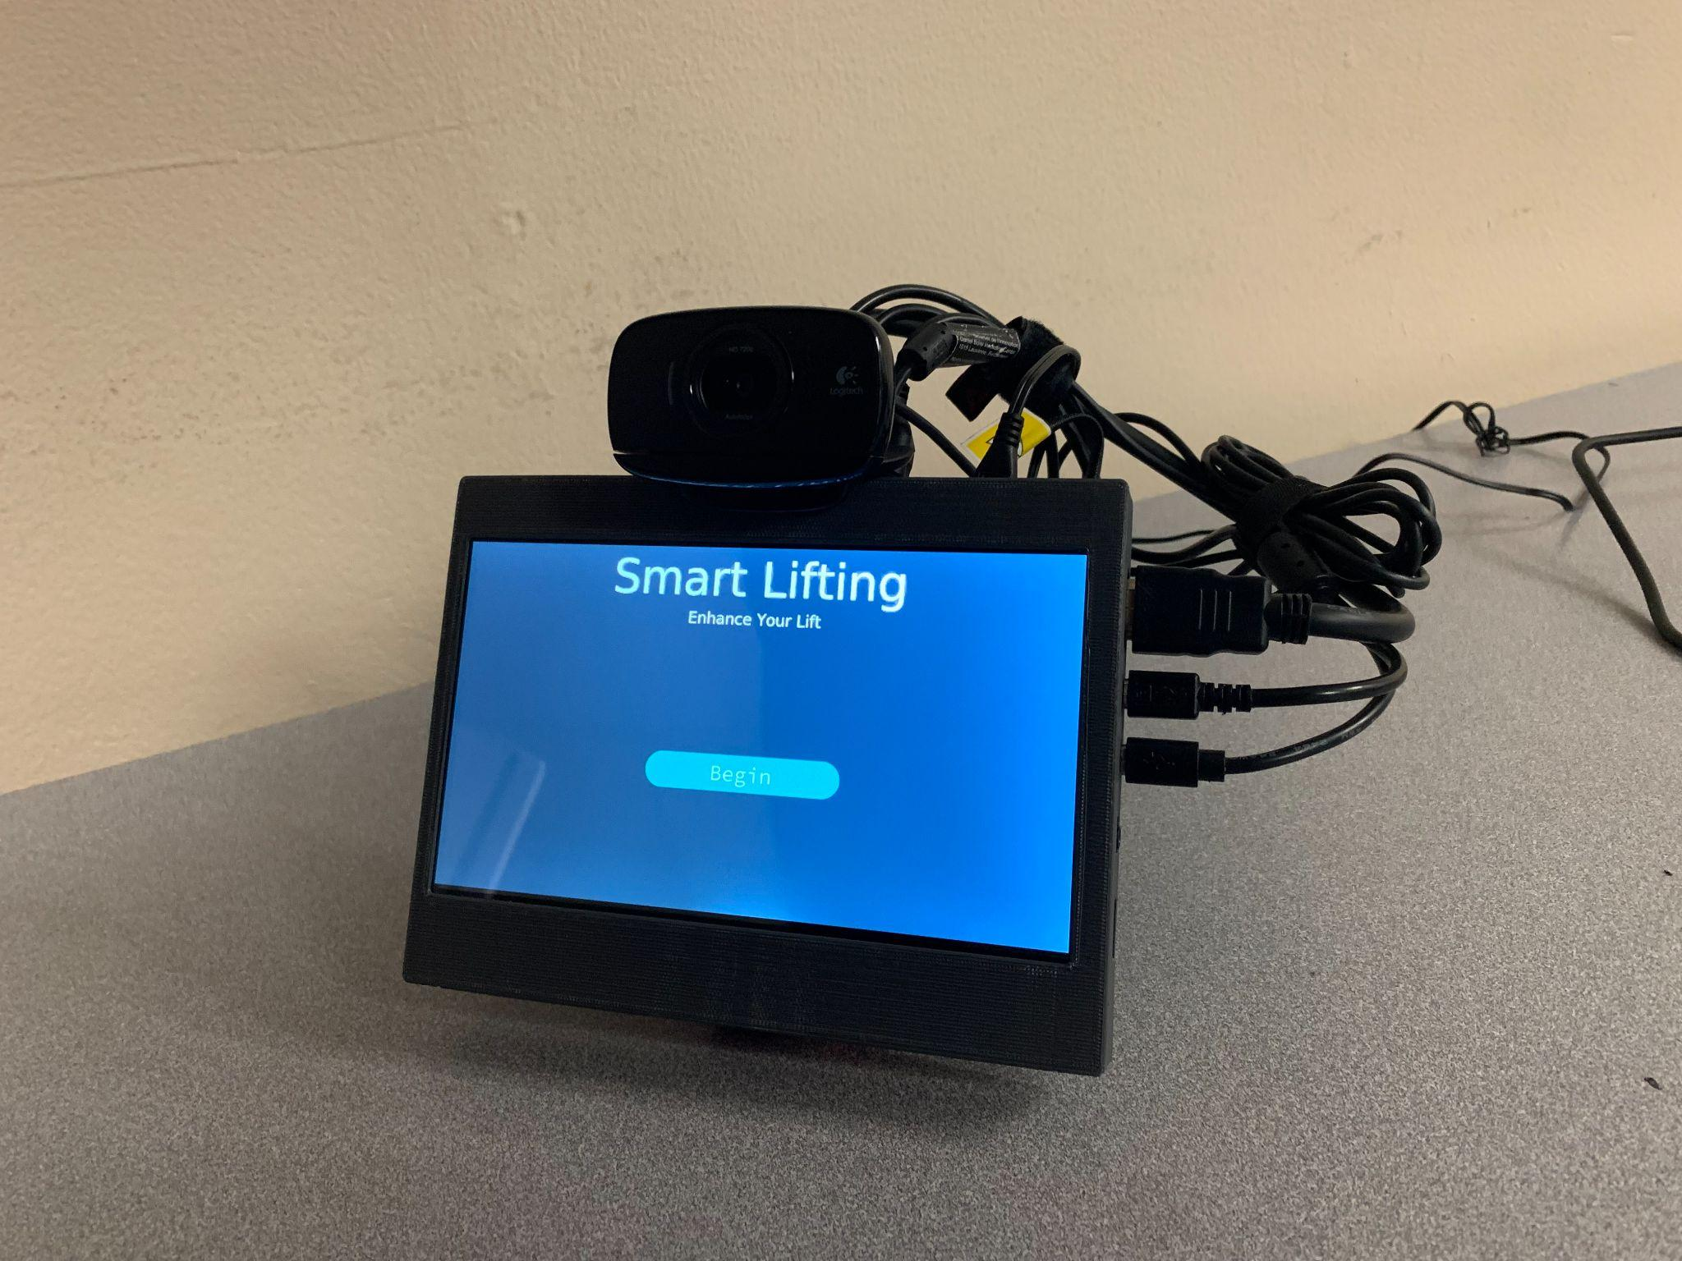
Concept Statement
The Smart Lifting product will aid new and experienced weightlifters by providing insights on proper form and technique. Smart Lifting is an autonomous system that utilizes pose detection and computer vision to record a person in real-time and calculate angle measurements to analyze form. In comparison to other products, Smart Lifting is a compact product that is easily portable.
Front-side View of Device

Slide 3
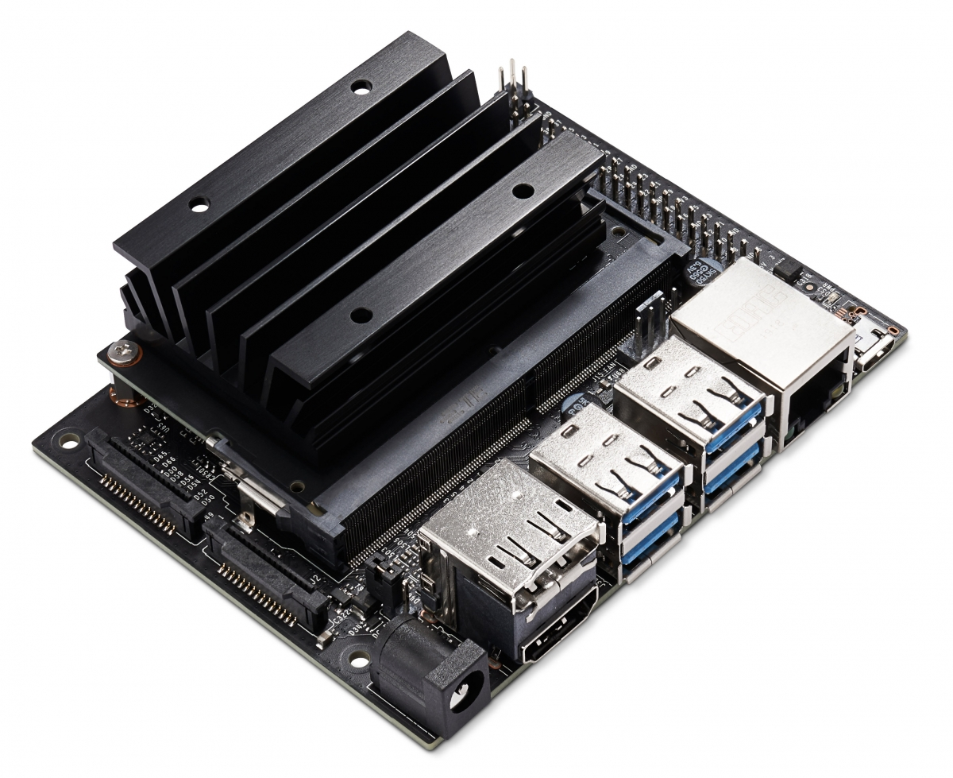
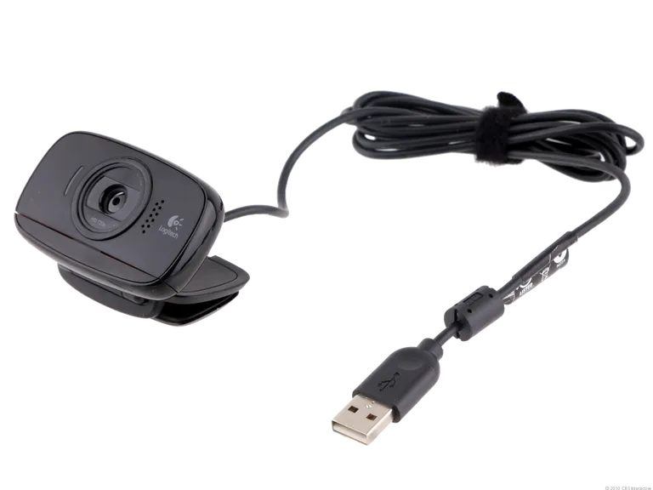
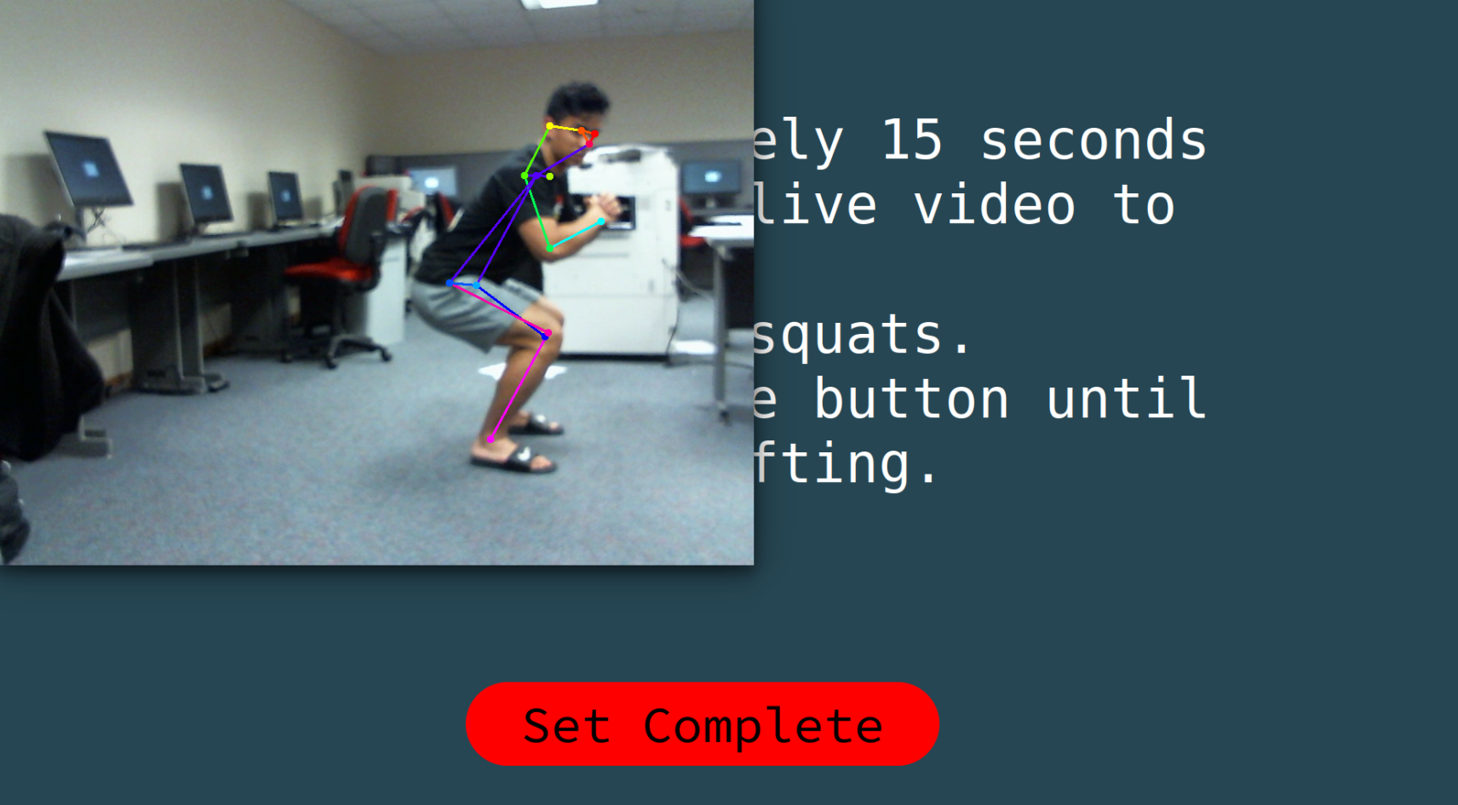
Smart Lifting Overview
01
Hardware
NVIDIA Jetson Nano 4GB (with SD card)
USB Camera
3D Printed Case
7” touchscreen HDMI display
02
Software
Computer Vision
Pose Detection - Angle Manipulation
XML Local Database
GUI
GitHub Repository -> Weight Lifting Coach
Screenshot of Live Video Recording

Slide 4
Related Works / Limitations / Cyber Security
Related Works
Perch Fit (https://perch.fit/)
Cell Phone
Limitations
Storage on SD card – local database
Not tailored to specific individual (i.e. ligament length) – impacts final score
Cyber Security
full screen application
buffer-overflow attack

Slide 5
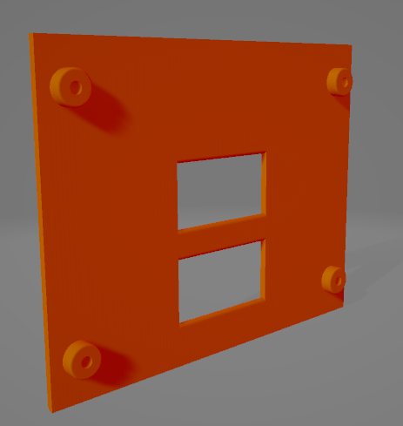
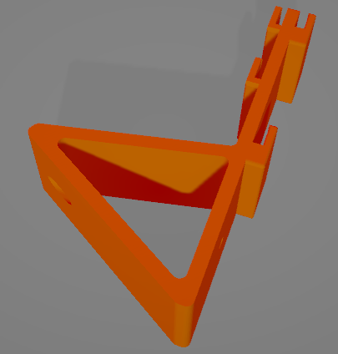
Implementation and Problems Within
Large device footprint
We solved this problem by utilizing a 3D printed case found online for the screen and a stand to hold it, as well as a custom-designed mounting bracket for the Nvidia Jetson
Poor camera
We solved this issue by utilizing a USB camera that enables the user to change the camera angle to fit their needs
3D Rendered Images of Device Encapsulation

Slide 6
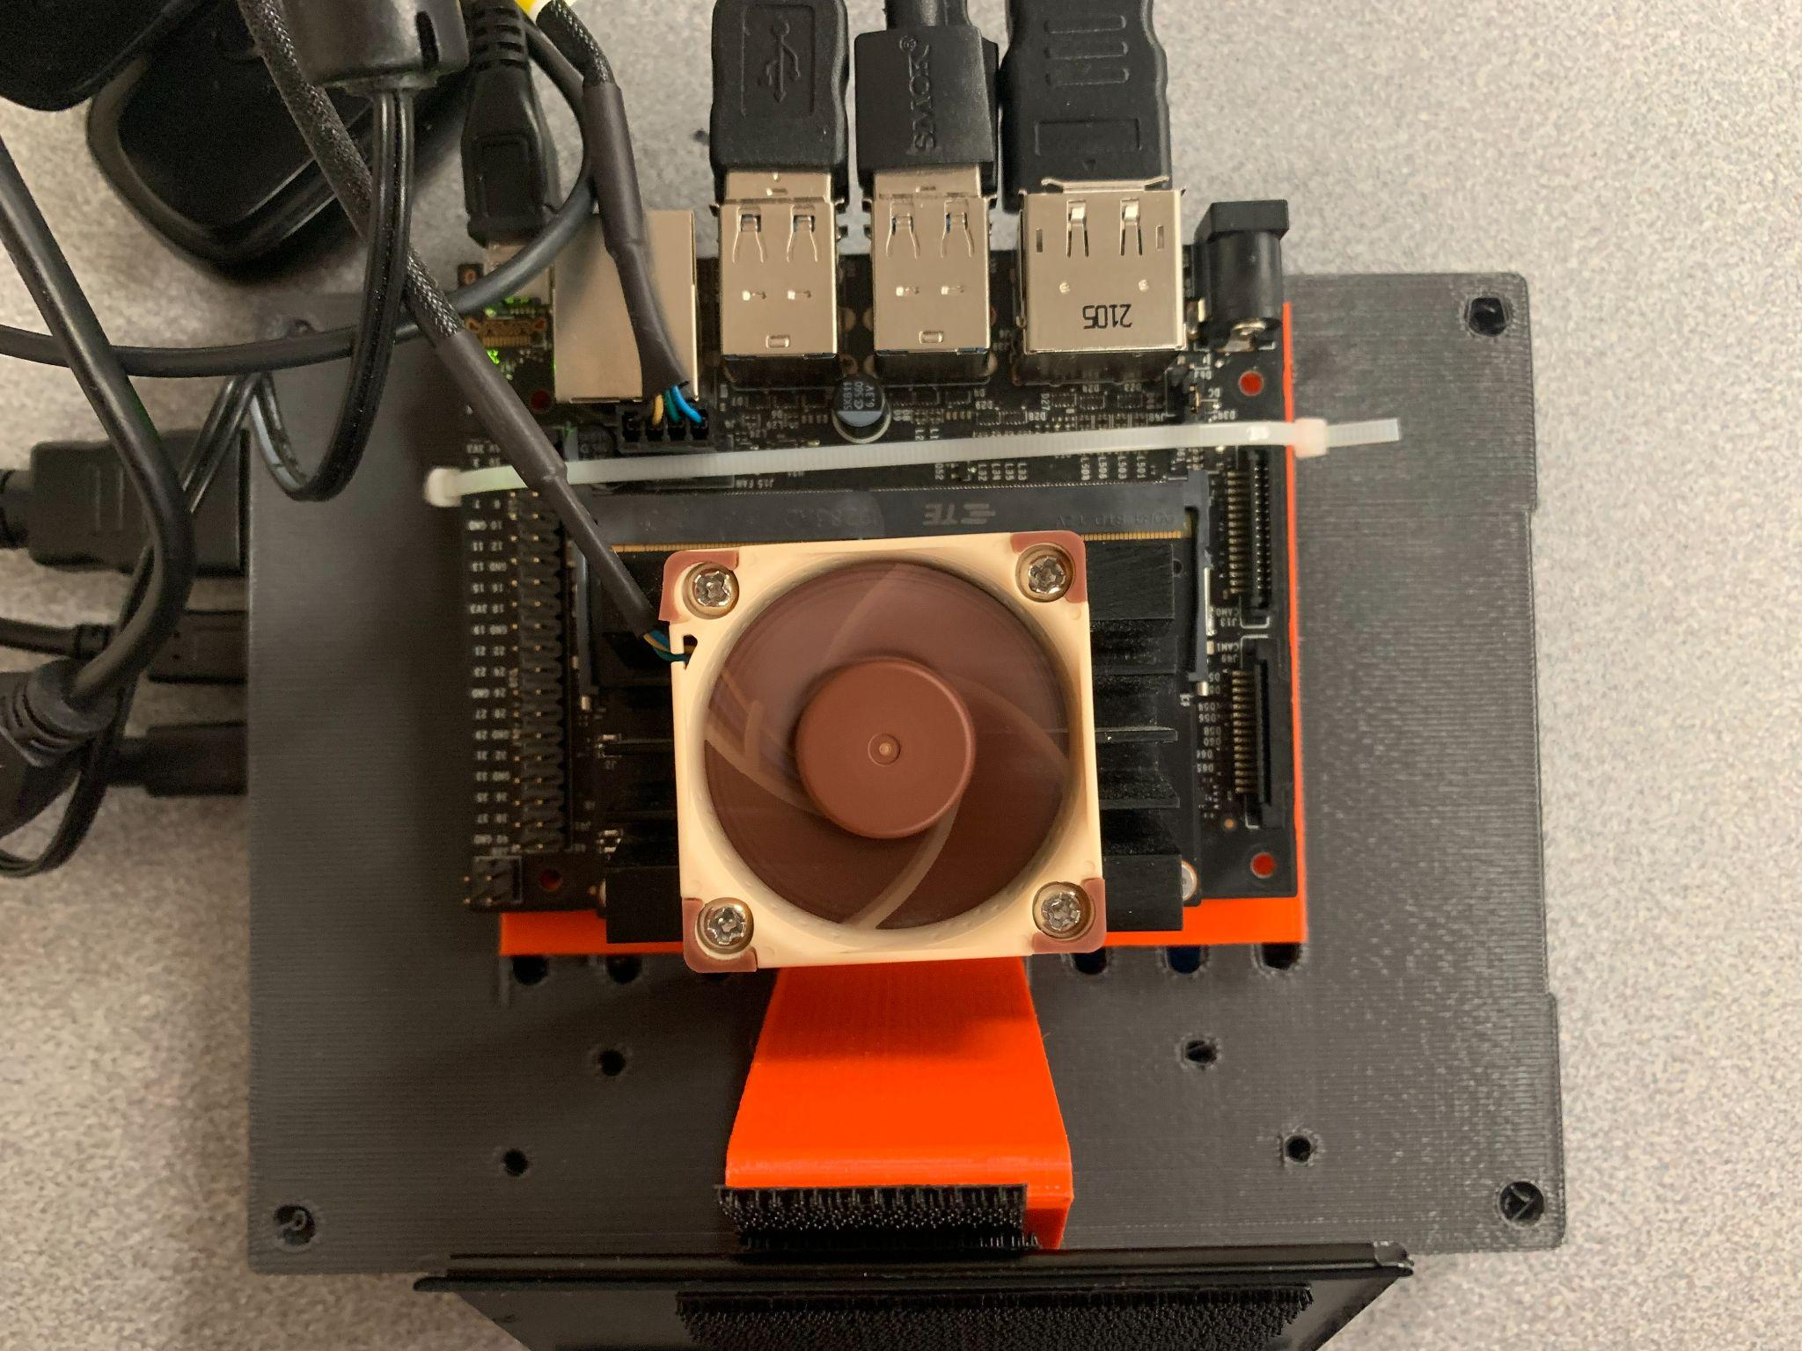
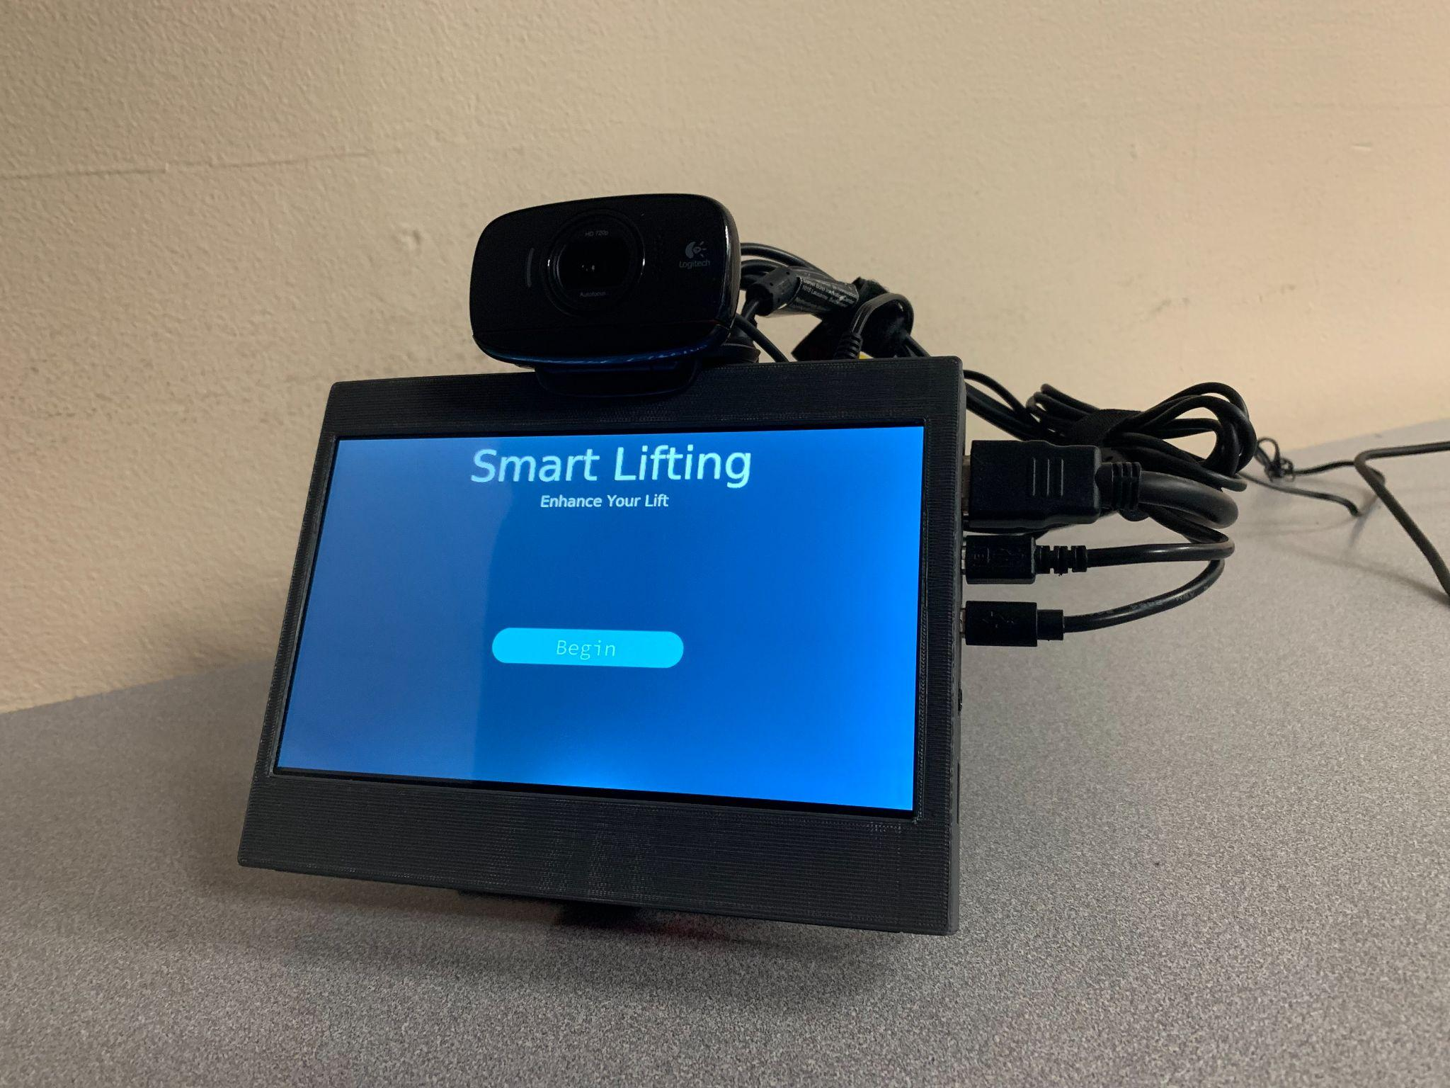
Implementation and Problems Within
3. Recalling lift results
We solved this issue by creating an XML document each time a lift is conducted in order to store that data for retrieval later
4. Score calculation
We made adjustments to the way the score is calculated to ensure a more accurate representation of how well the user performed
5. Linux environment variables
Back view of device
Front View of device

Slide 7
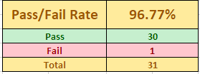
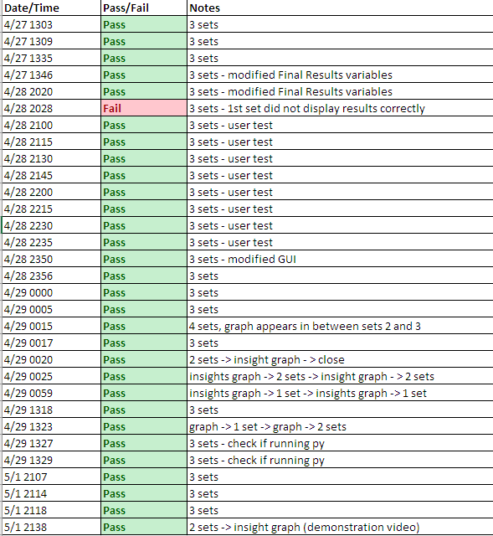
Smart Lifting Development Process
Design: diagram -> initial prototype -> final prototype
Implementation: Computer Vision, XML Database, 3D Modeling, GUI
Testing: Documented tests of system reliability and of user satisfaction
20%
60%
20%
Testing Log from 4/27-5/1
Design
Implementation
Testing

Slide 8
Product Testing & Evaluation
Acceptance Test
The user launches the program “pose_capstone.py” and waits at most 15 seconds for the program to load.
The user utilizes the program to record themselves performing 3 back squat repetitions as directed by instructions on screen.
User feedback is displayed on the screen. The user selects “next set” and repeats steps 1 and 2.
At the completion of the second set, the user views their final score and performance feedback graph.
Evaluation: NASA TLX and SUS Score

Slide 9
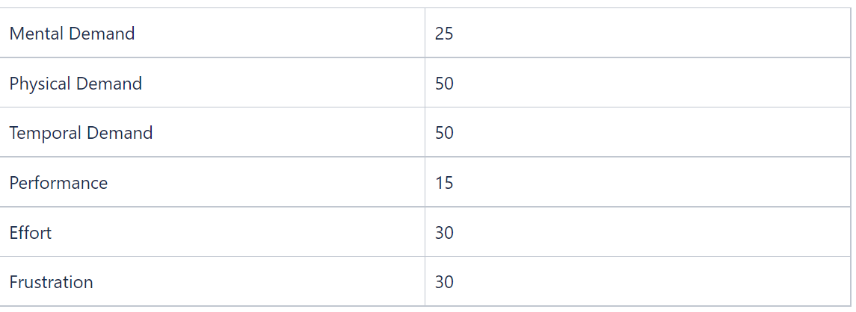
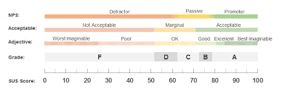
NASA TLX
SUS Score
Target Value: 78
Observed Value: 72
Above 50%, but did not reach target
Need to improve GUI for more direction to improve usability
Measurement of workload
Target focused on low workload for performance, frustration, effort.
Importance of usability
Results:
Effort - revise user commands/ directions
Frustration - final score
Measures usability

Slide 10
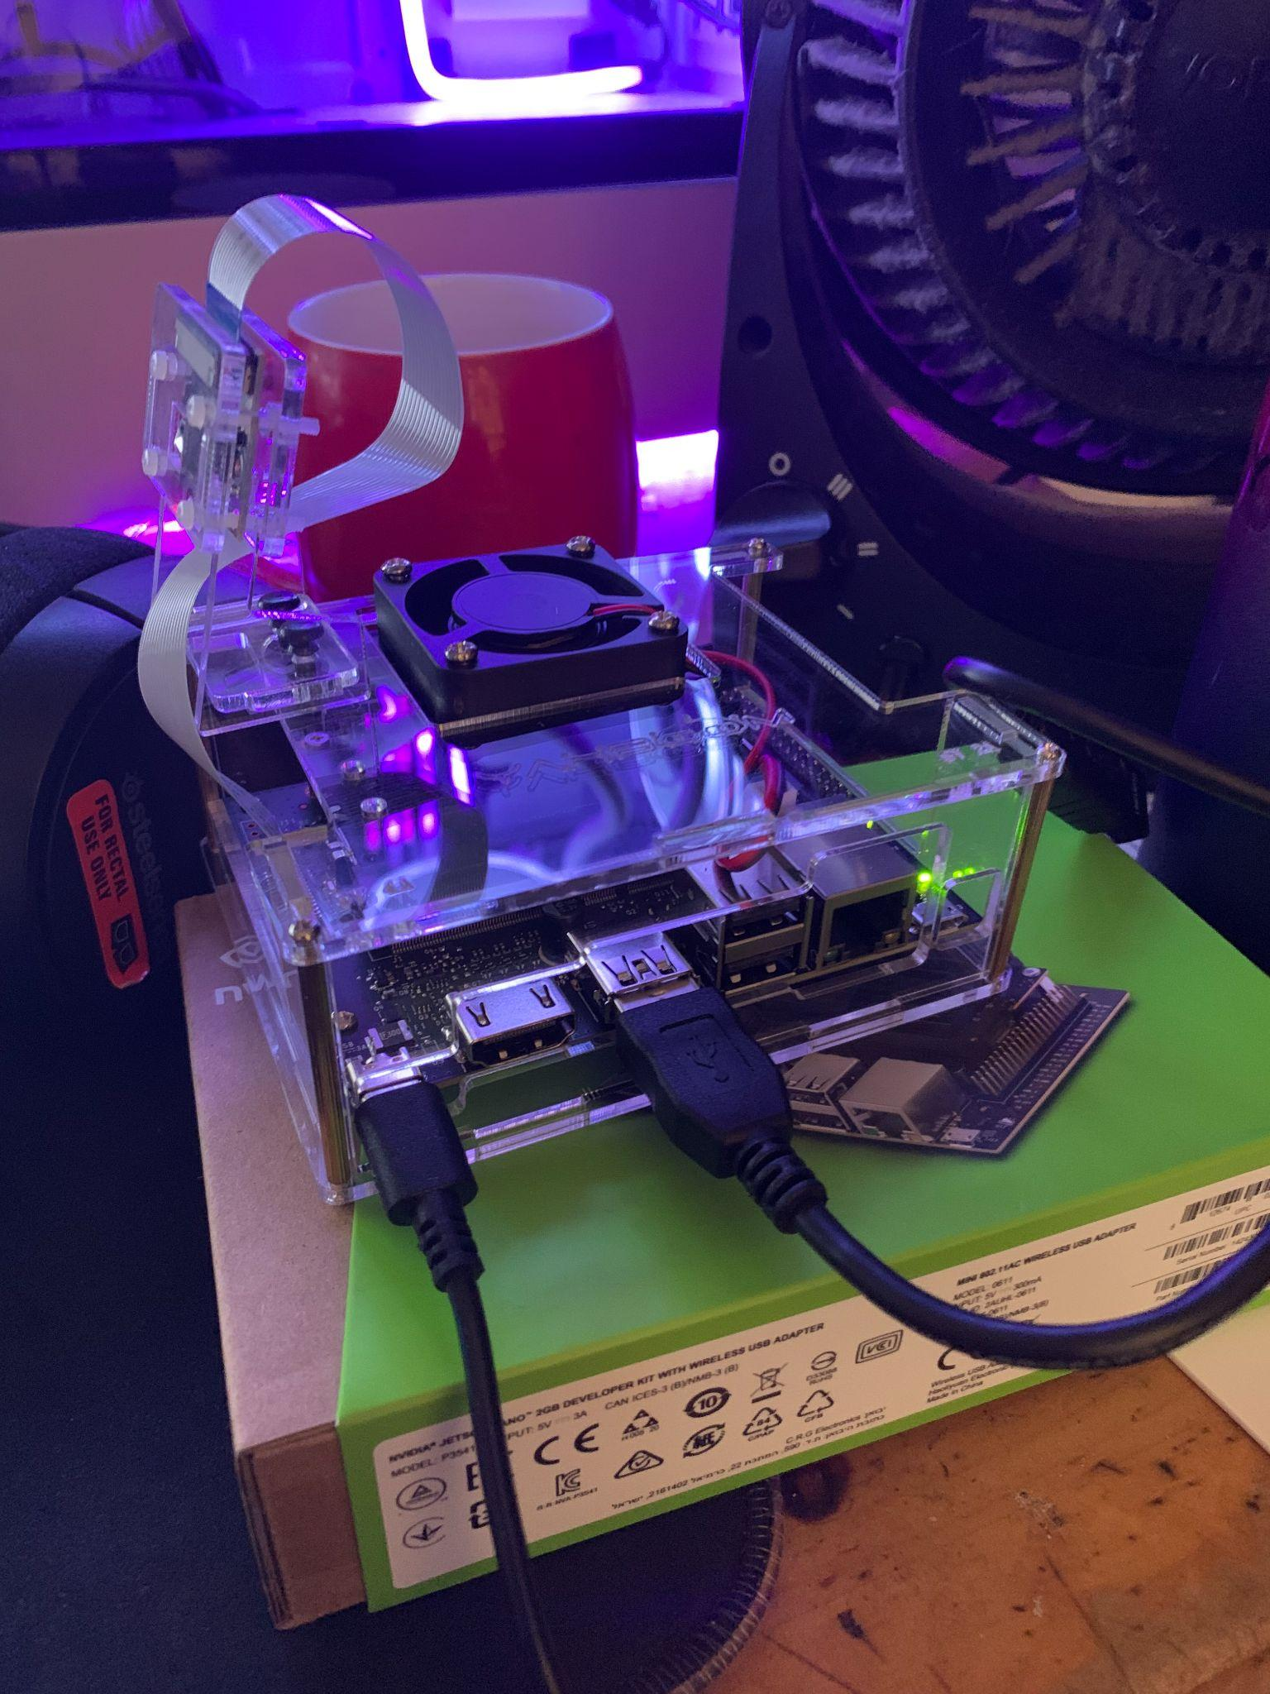
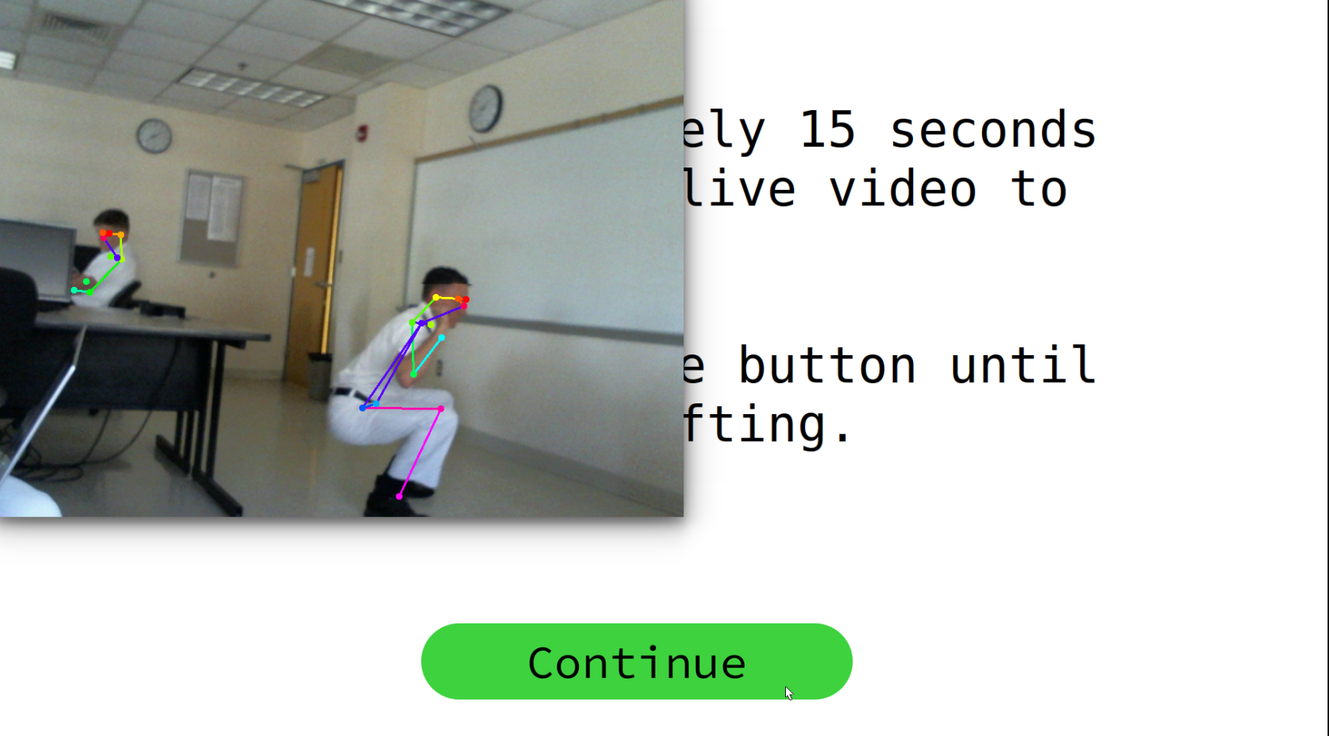
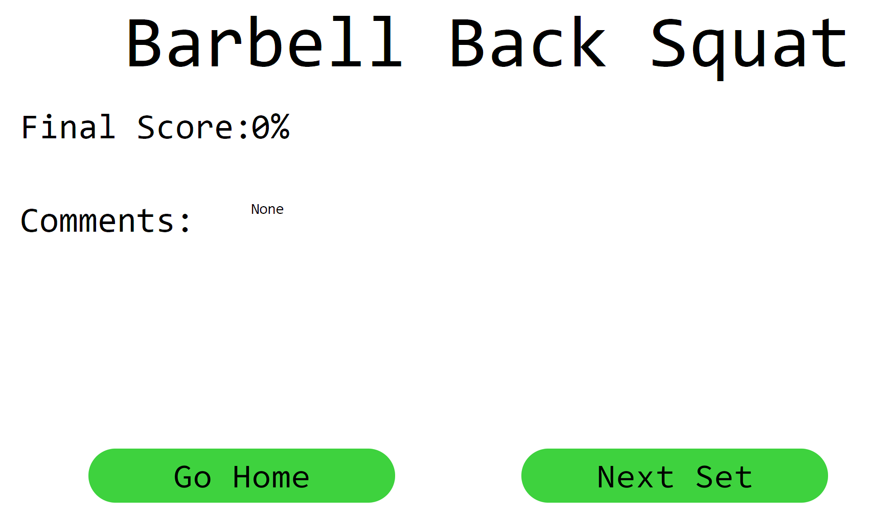
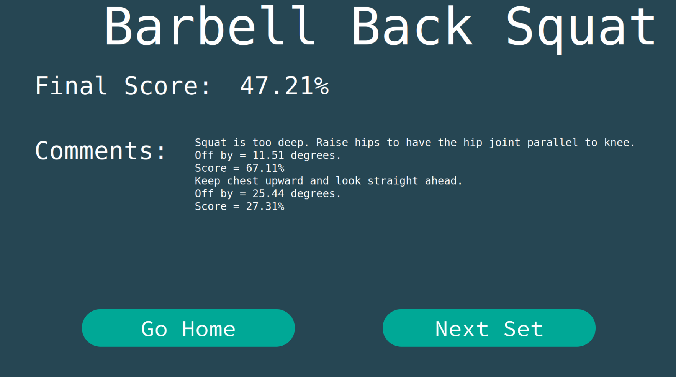
Results & Adjustments
Early Stages
Current Product
Adjusted “Complete” button → “Set Complete”
Changed GUI colors for improved user experience
Added more directions for user
Changed format for final score percentage for clarification (i.e. rounding)
Adjusted physical appearance (i.e. wires and stability)
Fixed GUI to eliminate desktop appearance

Slide 11
Conclusion
Future Works
Add more lift options (i.e. bench press, deadlift, clean and jerk, snatch)
Cloud storage
Incorporation into physical therapy and athletic training
User profiles

Slide 12
Questions?
Thank you for listening!

